Slide 1
miProbes Flask web app
Matthew McAvoy
July 31, 2020

Slide 2
Overview
Flask acts as back end for html pages
Dynamic (html is normally static; javascript limits to its dynamicity)
Allows for tables and graphs to be displayed using any supported dataset as well as user interaction with the graph
SQL for data storage (Sqlite for protoype, postgresql or Cassandra for later)
Accessible from any computer - no package errors or running console commands
Notes:
Flask is a python program that acts as a server for html pages. As it works within python, it allows dynamic content to be displayed on web pages that either would normally be static or require pre-calculated data and functions to add interactivity.

Slide 3
Class based file recognition
Supported file types
Magellan and Flourescence in file name -> MachineA
Assay in file name -> assay
MachineA and assay are two different classes that have functions that parse and create a dataframe from the raw file.
Barcode is not well supported. Currently it is static for uploaded experimental files, dynamic for assay files.

Slide 4
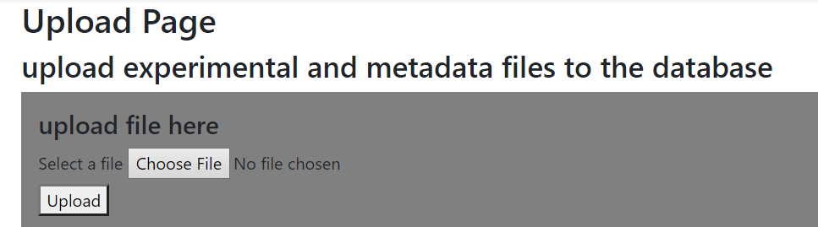
Select a file
Experimental currently only in csv format
Assay either in csv or xslx format
Click upload
In five seconds or so, the table should be updated. If the file is an experimental file, the heatmap should also be updated and display

Slide 5
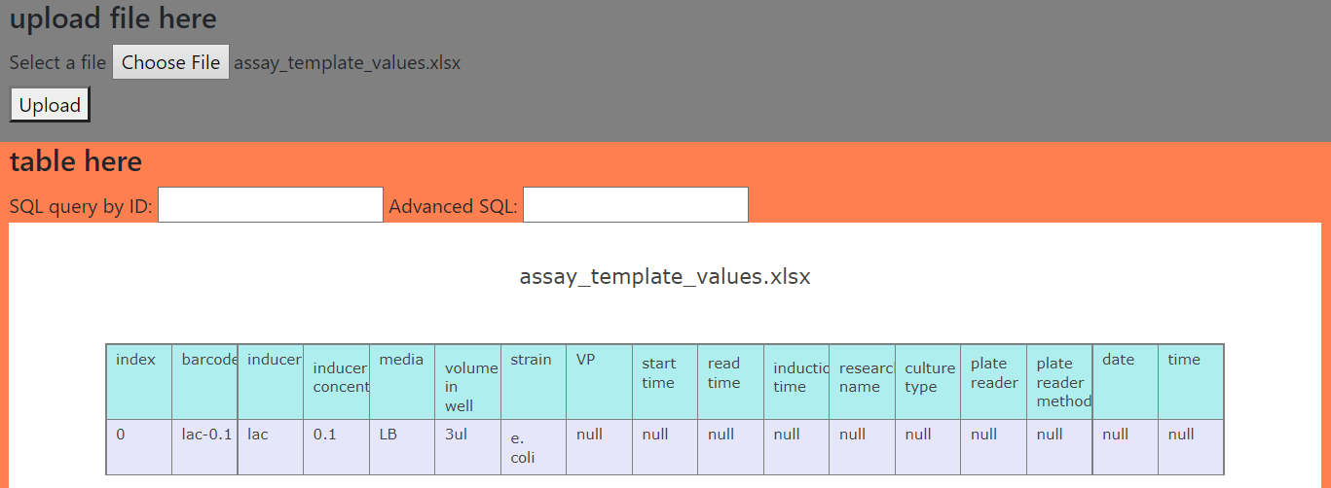

Slide 6
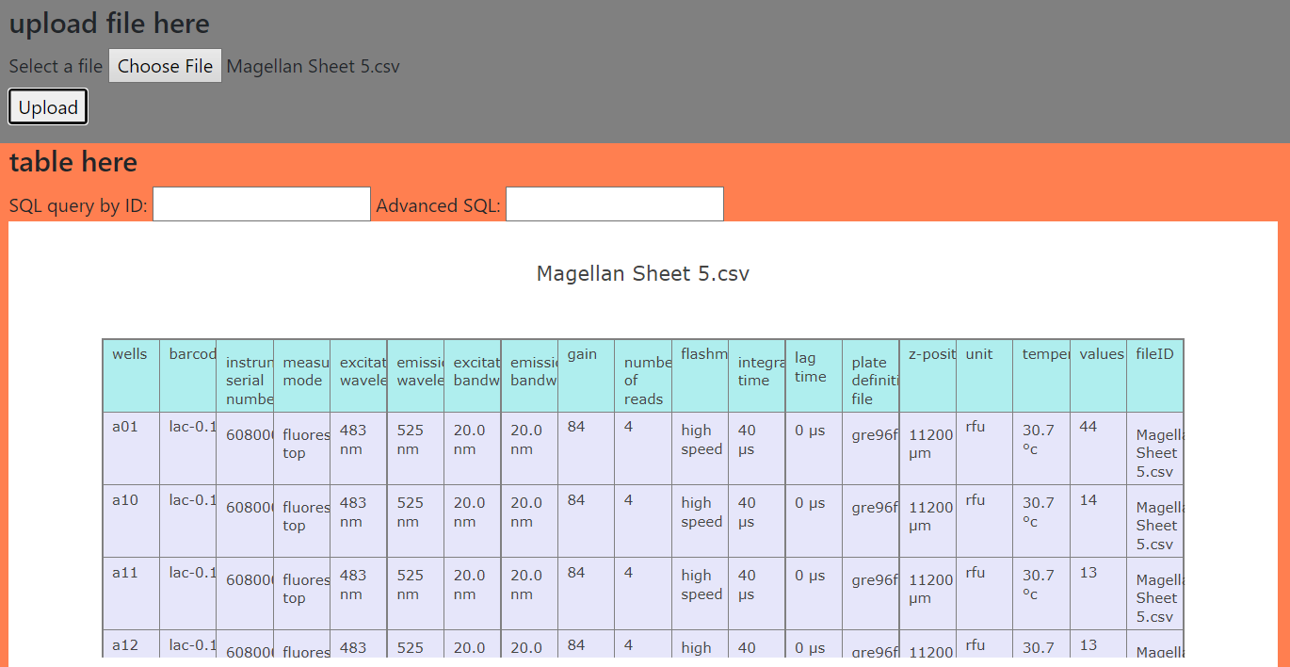

Slide 7
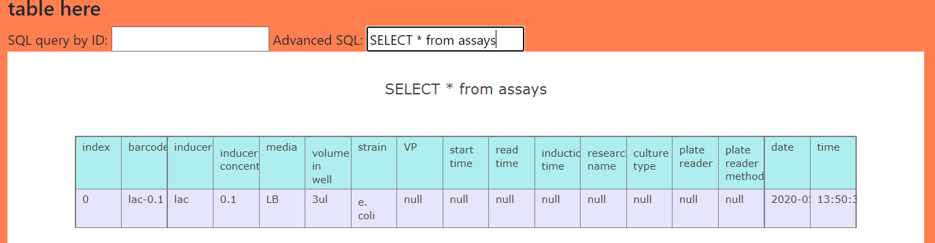
Type a proper SQL statement into the Advanced SQL textbox and hit enter
Tables: assays, assayLayout, experiments
Date and time are updated once an experiment with a matching barcode is added to the database.

Slide 8
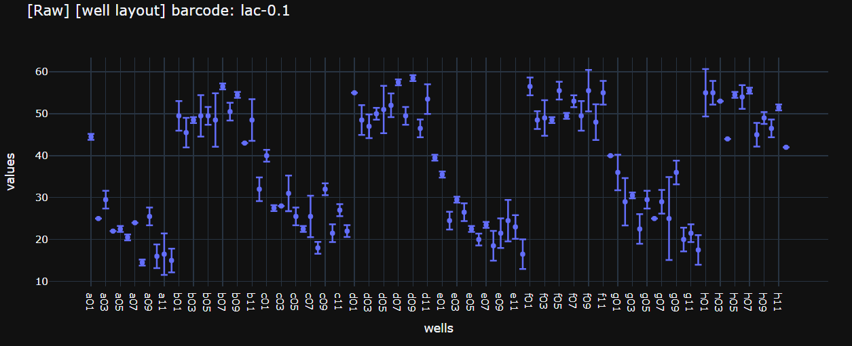
Well layout
SELECT * FROM experiments WHERE barcode == ‘{}’
If replicates, can calculate mean and std, which can be included in plot

Slide 9
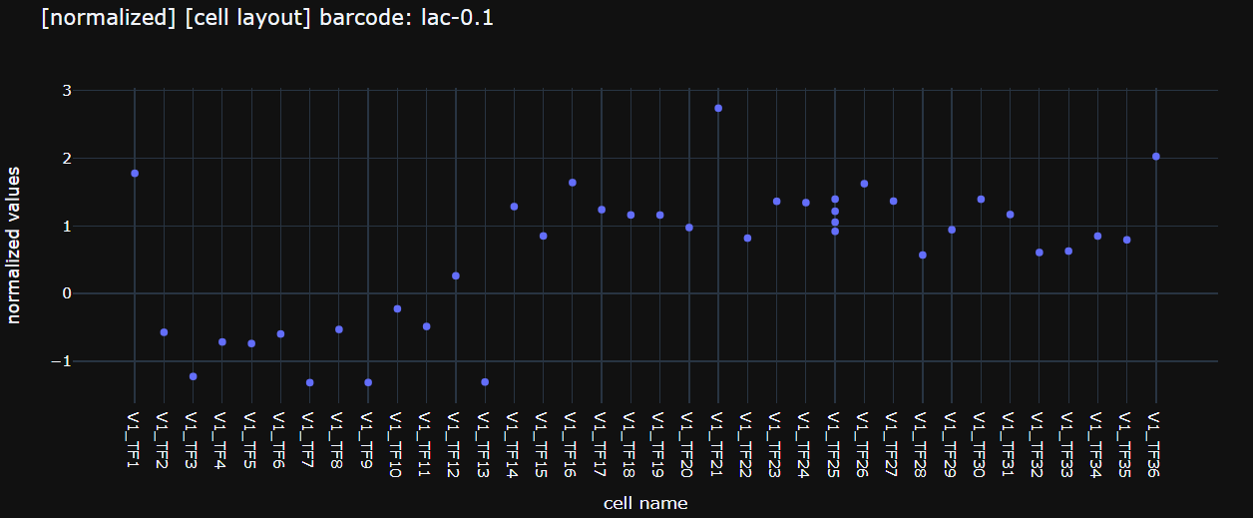
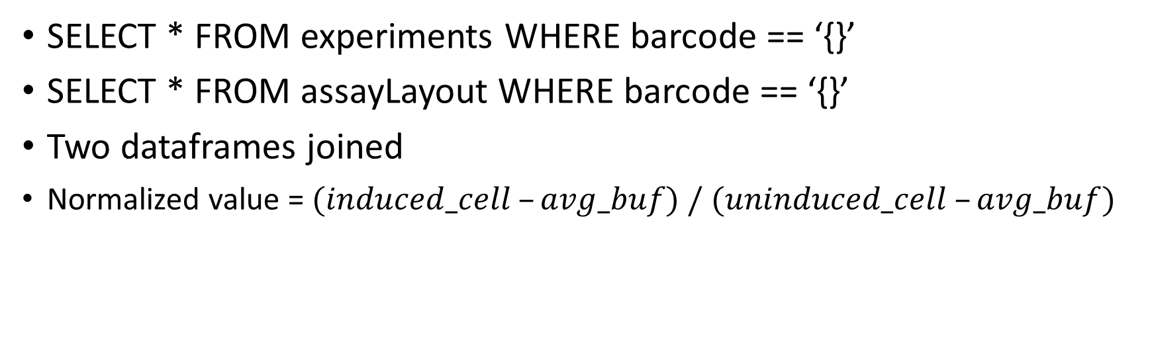
Cell layout
SELECT * FROM experiments WHERE barcode == ‘{}’
SELECT * FROM assayLayout WHERE barcode == ‘{}’
Two dataframes joined
Normalized value = $(induced_cell –avg_buf) / (uninduced_cell –avg_buf)$

